Slide 1
Polyatomic Ions and Compounds

Slide 2
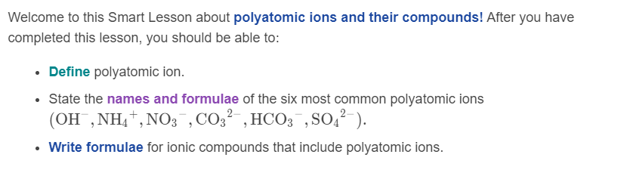

Slide 3

All of the ions we have looked at so far have been monoatomic ions. This means they are charged particles made up of just one atom (mono means one).
Polyatomic ions are charged particles made up of multiple atoms (poly means many).

Slide 4
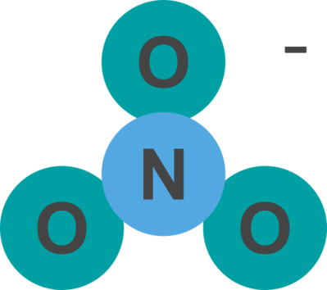
The charge on a polyatomic ion is associated with the whole group of atoms that make up that ion.
The atoms within the polyatomic ion are non-metal atoms that are covalently bonded together, which means they act as a single unit when in an ionic compound. The charge is "delocalised" over the whole group of atoms, not localised on any one atom.
Just like other ions, the charge is written as a superscript after the formula of the ion. For example, a nitrate ion is made up of one nitrogen atom and three oxygen atoms. Its formula is NO₃^{​−}.

Slide 5

Polyatomic ions are generally named based on which atoms make them up.
Polyatomic ions that contain multiple oxygen atoms usually have the suffix -ate. For example, SO₄​²⁻ is the sulfate ion, because it contains sulfur and oxygen atoms, while CO₃​²⁻ is the carbonate ion, because it contains carbon and oxygen atoms.
The two polyatomic ions that you need to know that aren't named using -ate are the hydroxide ion (OH⁻), which is made up of hydrogen and oxygen, and the ammonium ion (NH​₄⁺), which is made up of nitrogen and hydrogen.

Slide 6
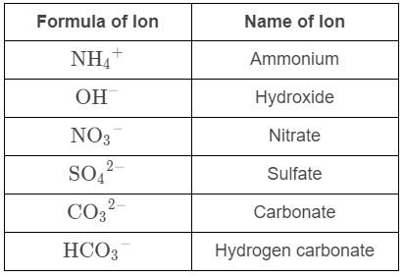
The table below contains the six polyatomic ions you need to know. You are expected to learn their names.

Slide 7
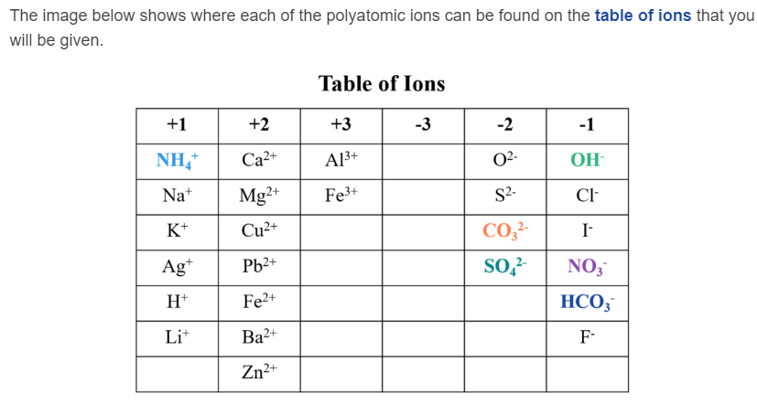

Slide 8

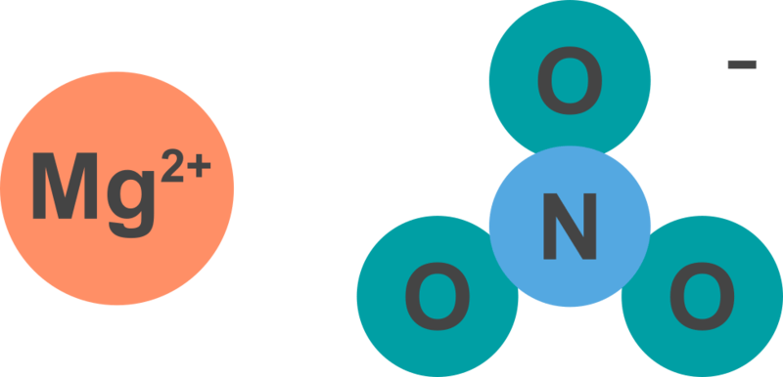
Writing formulae for polyatomic ions.
Consider the following two formulae:
This first formula indicates that there is one magnesium ion and two nitrate ions. The second formula indicates that there is one magnesium ion, one nitride ion, and 32 oxide ions! Which one do you think is correct?

Slide 9
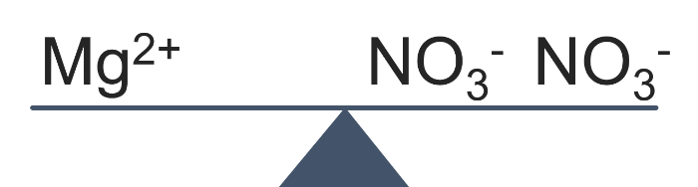
Brackets indicate that the number following them applies to everything inside the brackets.
Therefore, the correct formula is the one containing brackets. The formula Mg(NO₃​)₂​ shows that this compound contains one magnesium ion (Mg²⁺) for every two nitrate ions (NO₃​⁻). This is the ratio of ions that results in a neutral ionic compound.

Slide 10
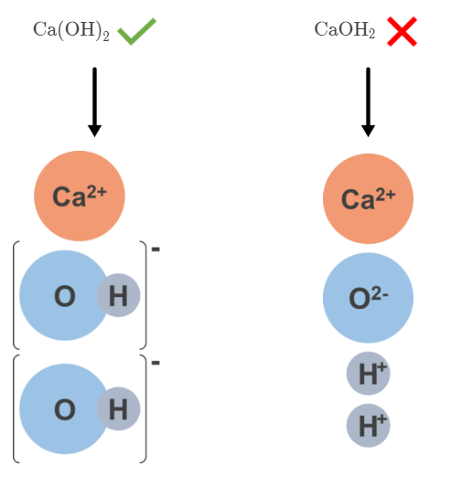
When writing chemical formulae containing multiple polyatomic ions, you must include brackets around the polyatomic ion.
The brackets indicate that the following subscript number relates to all of the atoms within the brackets.

Slide 11
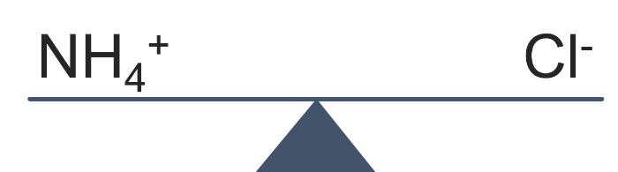
Brackets aren't required when the ionic compound formula contains only one polyatomic ion.
For example, ammonium chloride is a compound made up of the ions NH​₄⁺ and Cl⁻. In order to balance the charges, one ammonium ion is required for each chloride ion. The formula is simply written NH₄​Cl.
Balanced!

